Slide 1
Creating Guidance from UI Audits
Catching the Horse and Closing the Barn Door
David Finnerty
March 30, 2021

Slide 2
Problem: Many areas of the Polaris UI seem to be the result of differing design decisions, even though those areas essentially perform the same functions, particularly those involved with the creation and management of objects. These functions basically involve the same simple repeated workflows. These ease of workflows should depend largely on the consistent placement and presentation of messages and affordances – by introducing inconsistencies, we are disrupting the user’s ability to recognize those patterns and making users work harder to remember those patterns.

Slide 3
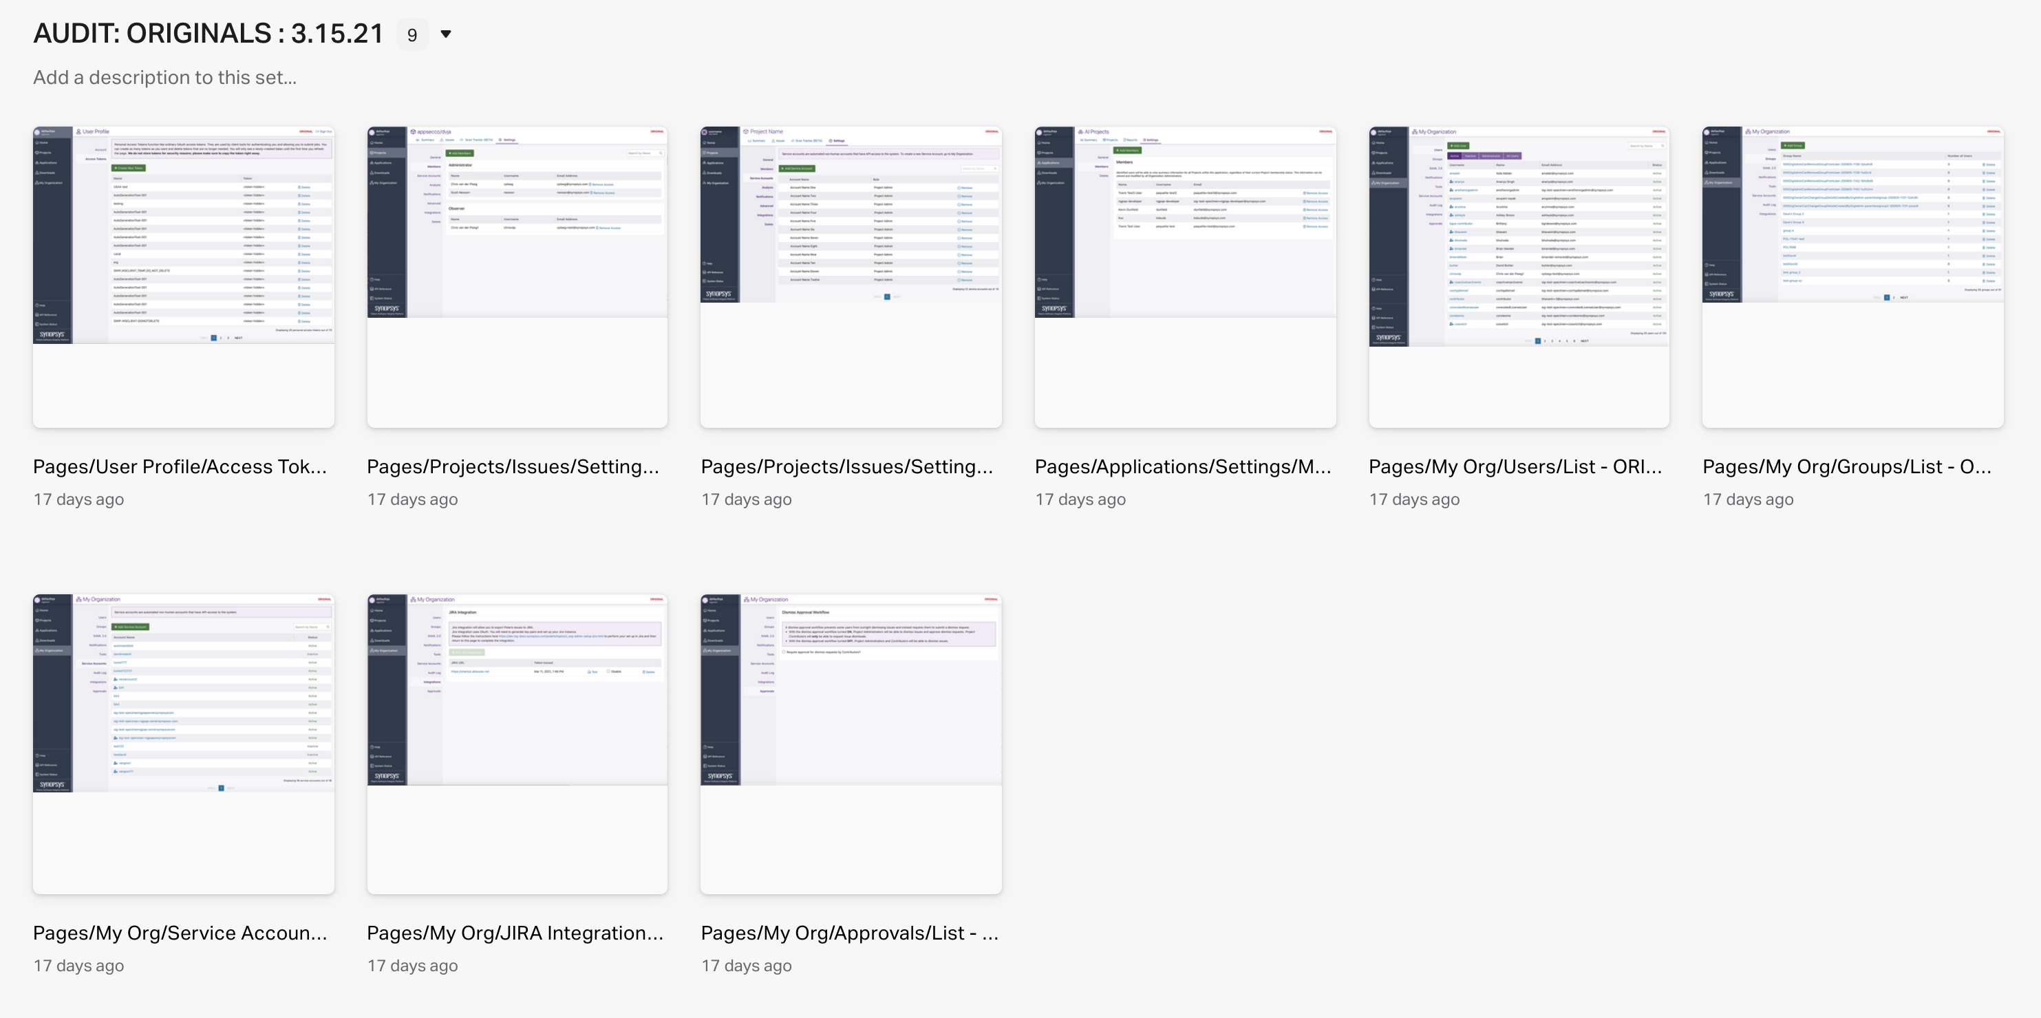
Identifying those inconsistencies: In order to identify these inconsistencies, both in terms of style and behavior, frequent UI audits should be initiated a regular intervals. Having exposed those inconsistencies, the question then becomes ‘which is the correct way?’ However, it is impossible to divine the answer, because there is no proper guidance in place. Without guidance, inconsistencies will invariably be introduced into the design and development process. Inconsistency is the horse and guidance is the barn door!

Slide 4
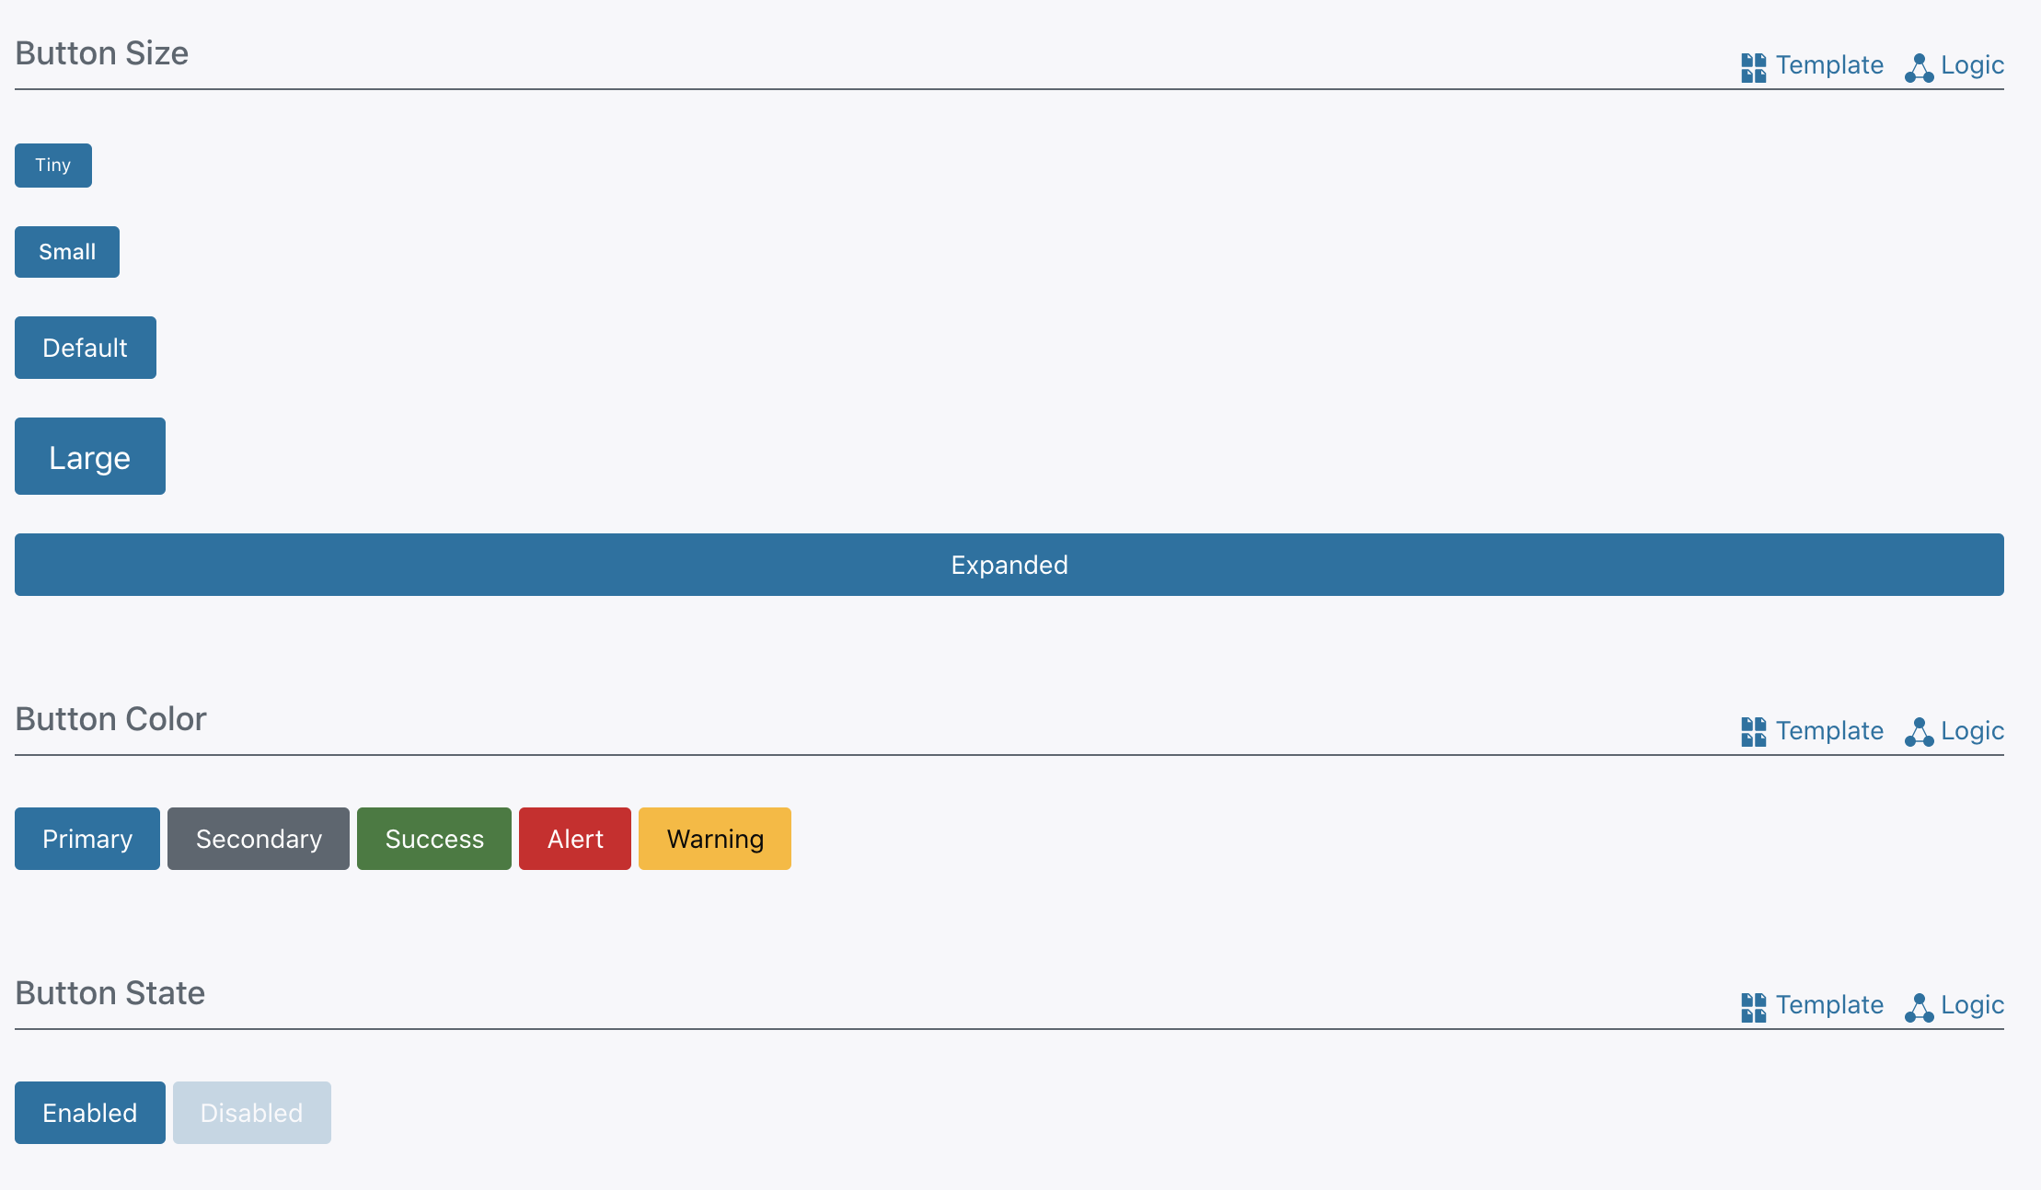
So where is the guidance? We do have guidance of a sort, but it is largely confined to how UI patterns are to implemented and configured by FE developers. In addition, it does not speak to how different patterns should relate to each other, nor does it speak to issues like content strategy or structure, color use, language or general layout foundations. We must therefore create designer-specific guidance to keep the horse from bolting.

Slide 5
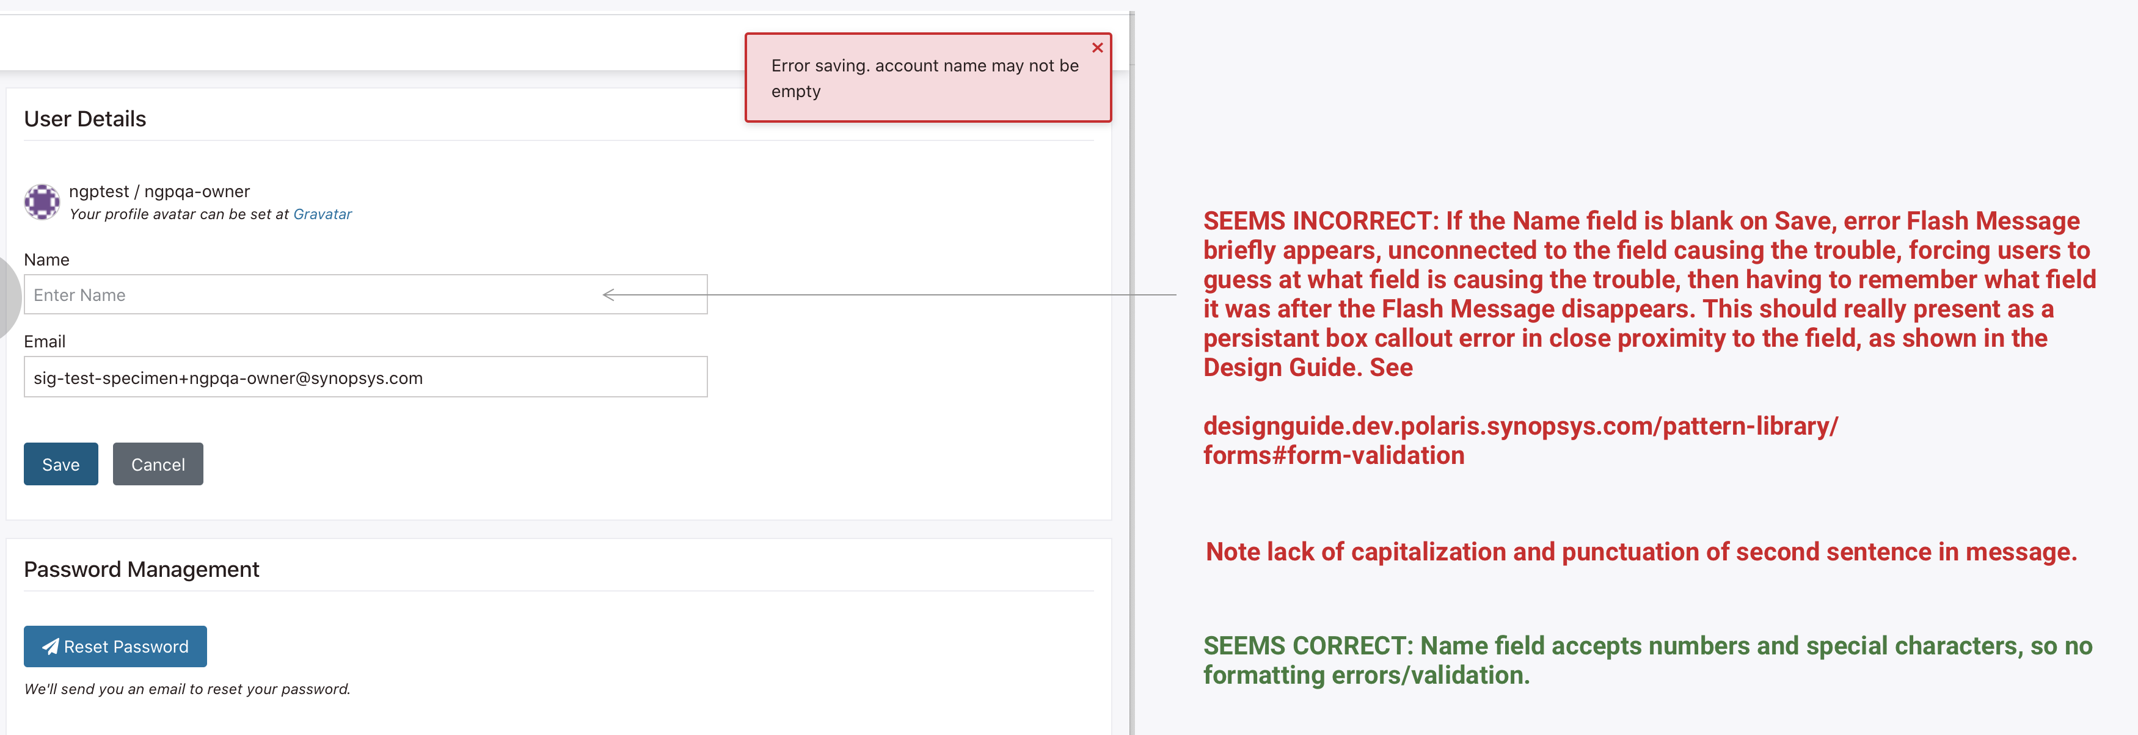
How do we create the guidance? Without guidance written down, we need to take it upon ourselves to study the UI and find where it look and behaves in an unexpected way through an audit. The audit should illustrate those areas of the UI where the look and behavior deviates from what the auditor expected. The auditor may then make recommendations that may resolve this unexpected look or behaviors. These discrepancies need to be put in front of the UX/UI team, who may choose to overrule or endorse any recommendations any auditor may make.

Slide 6
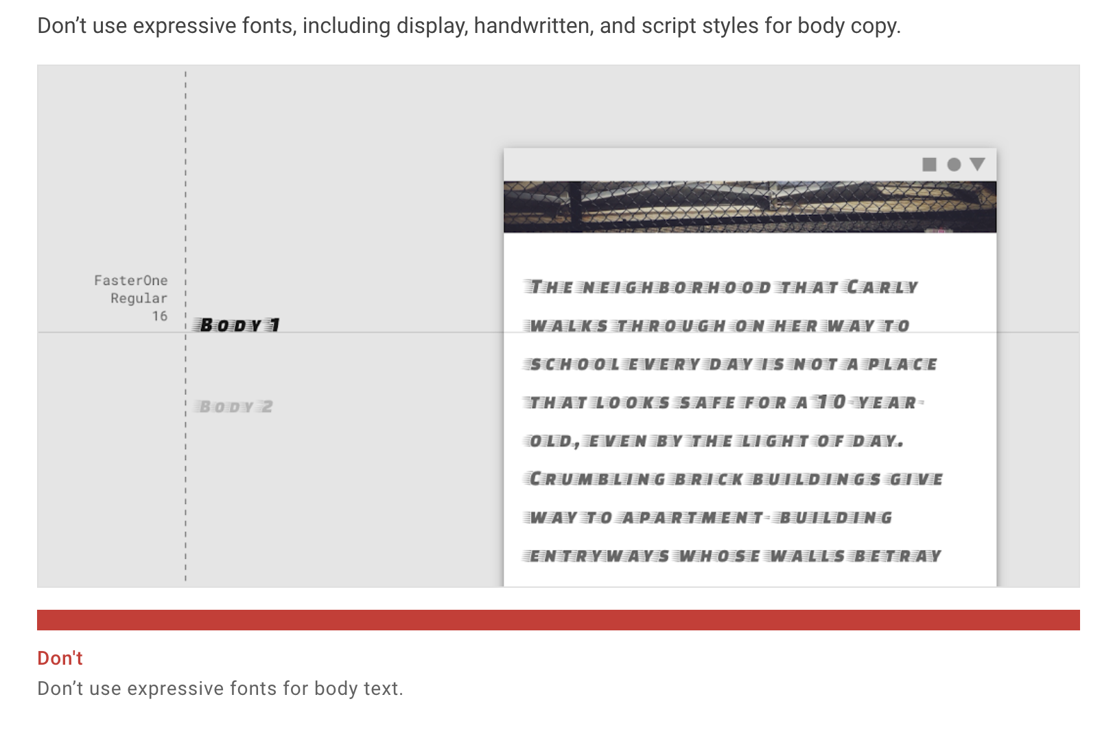
How do we create the guidance? Once the team endorses a proposed change in the UI, we should capture that team decision and use it to create guidance, starting with simple Dos and Don’ts that can be illustrated easily and expanded on. Deciding on what NOT to do is a good starting point for guidance creation. Many Design Systems use the concept of Dos and Don’ts to establish basic style and behavior guidelines. This not only applies to the look and behavior of individual components, but of entire workflows as well. Material Design does this quite well.

Slide 7
Where can we put the guidance? Right now, the interactive Nucleus Pattern Library is not very conducive to an easy content editing process, as it involves downloading the SWIP-Front End project on GitLab and merging changes in. For now, we should place any and all guidance, produced by a combination of both deliberate research and frequent audits, on Confluence where we can have more accessibility and flexibility in organizing and editing this content. As an interim measure, we may link the Confluence guidance from the Nucleus Pattern Library.

Slide 8
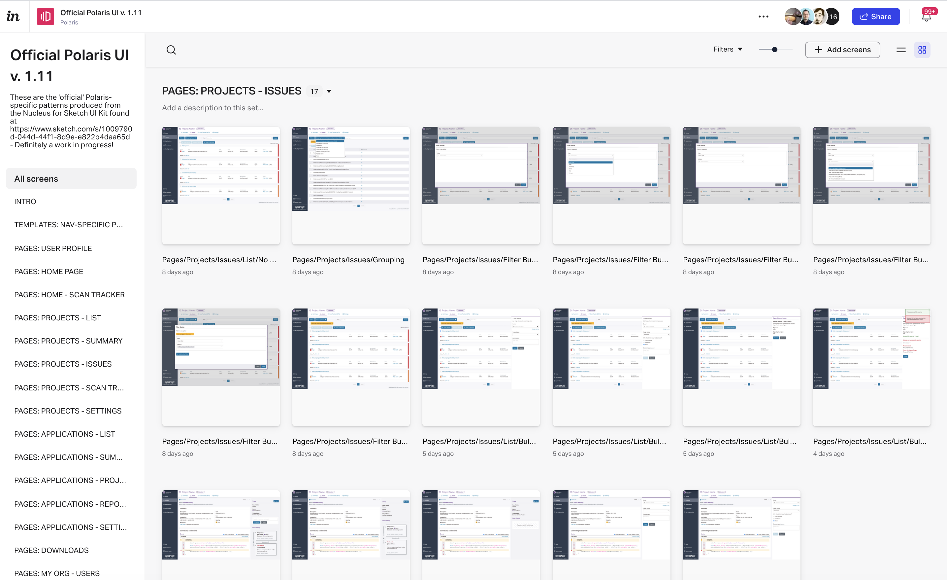
What else can serve as guidance? In addition to the written guidance, you can also find illustrated examples of how the guidance comes together by checking out the Official Polaris UI inVision Project, which is constantly updated as new patterns and components are implemented to support features presented at the end of every sprint. In addition, new pages will be added to dive further into individual page and component states. The more guidance, the stronger the barn door!

Slide 9
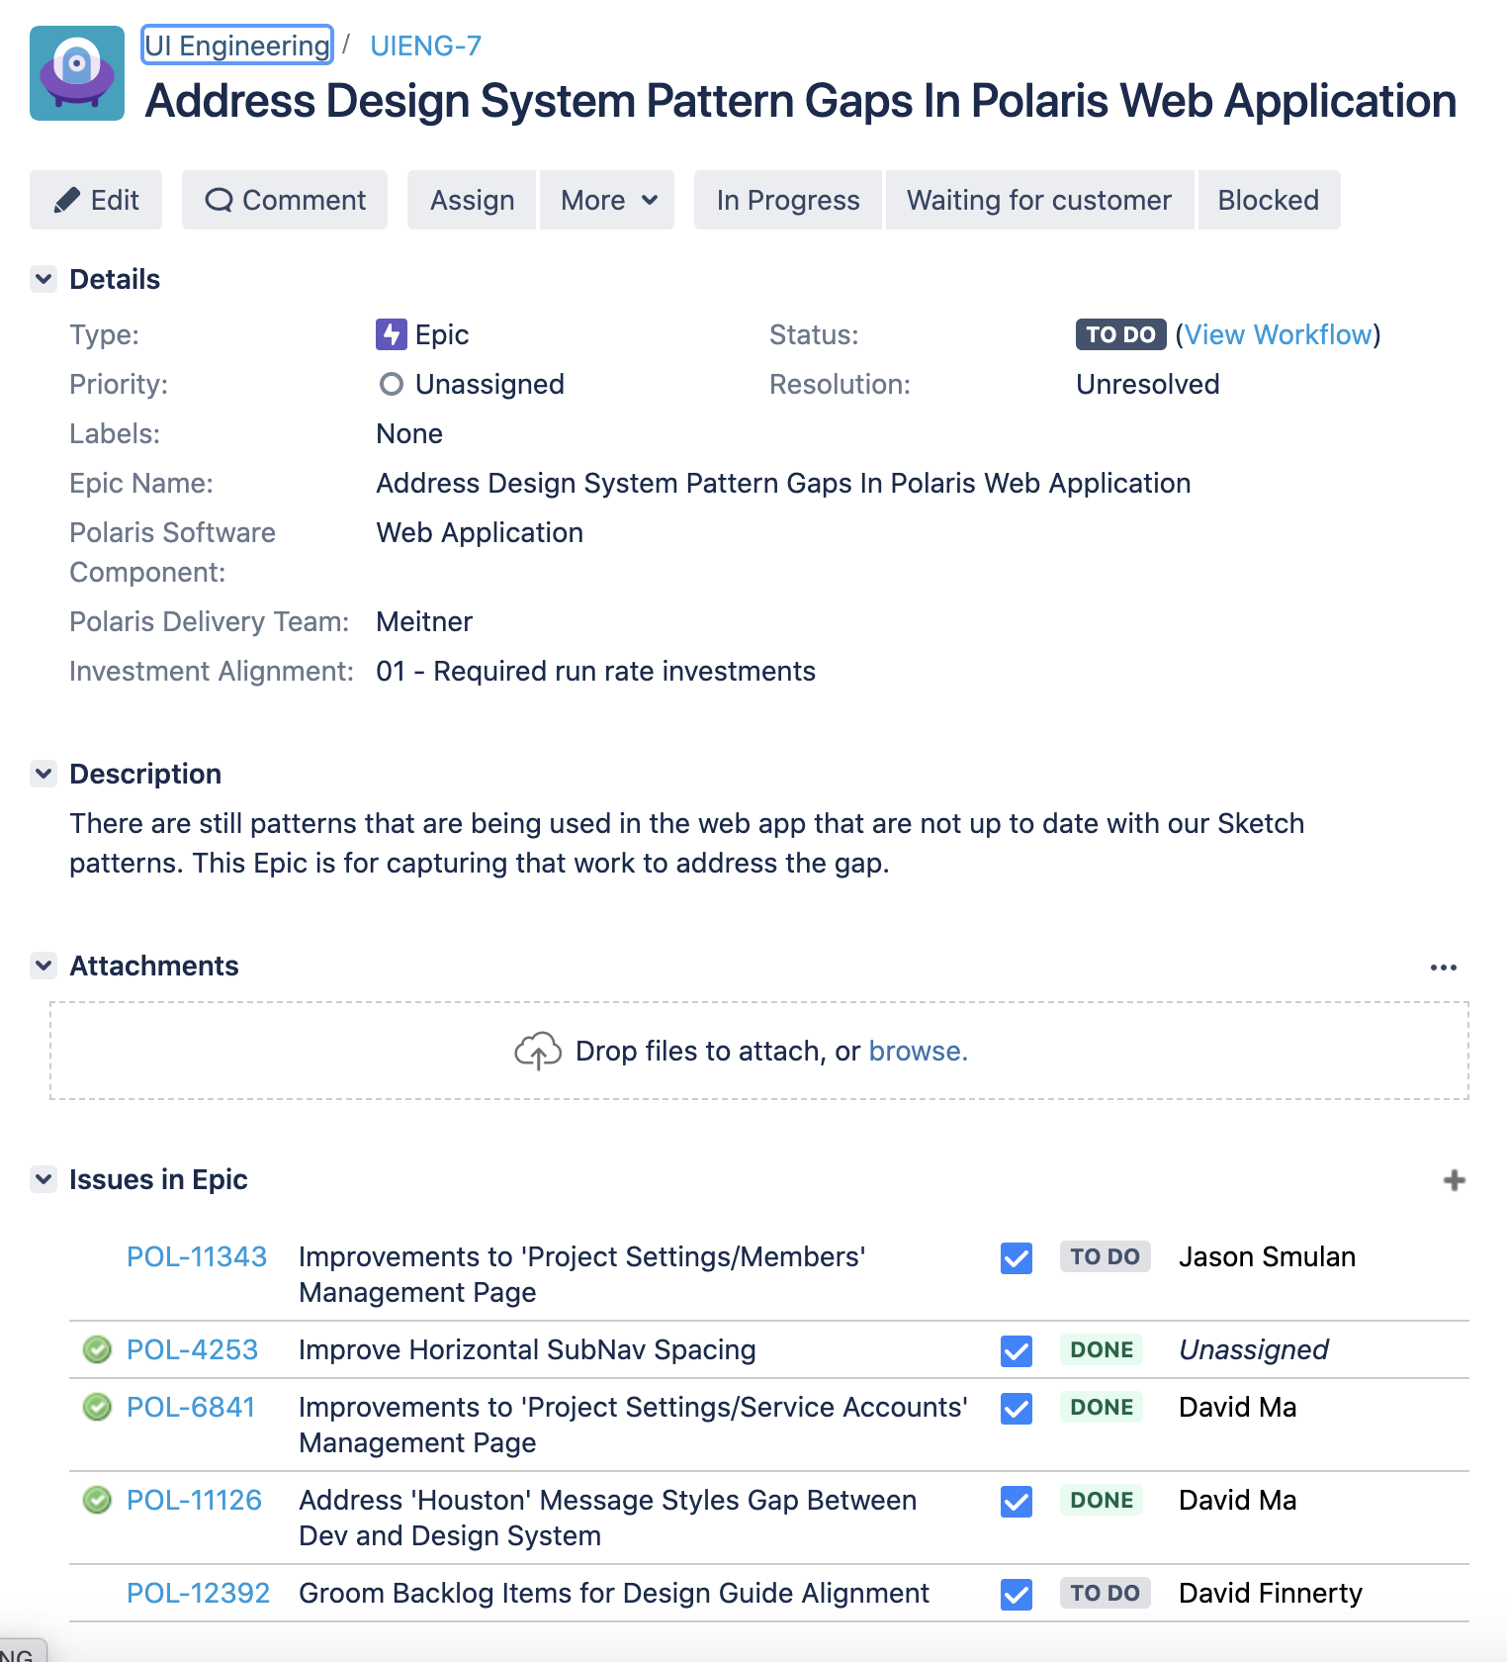
Catching the horse Another result of frequent audits will be taking team-approved recommendations and not only translating them to guidance, but also creating remedial tickets in JIRA under the ‘Address Design System Pattern Gaps In Polaris Web Application’ epic to allow the UIE team to address these issues, many of which are ‘easy wins’ (low effort/high impact) that can be prioritized accordingly. As we develop stronger guidance, we should end up creating such tickets at a much slower rate, allowing UIE more time to concentrate on features and UI maintenance and less time duplicating work on restructuring pages and components. Design based on strong guidance makes less work for developers!

