Slide 1
Building a Better Design System
Current Efforts to Improve Nucleus for both Designers and Developers by Dave Finnerty

Slide 2
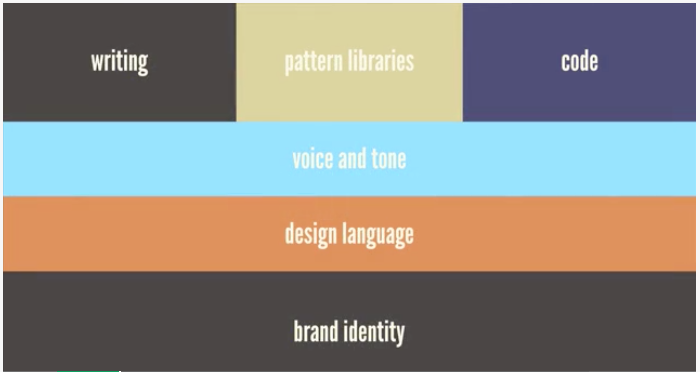
Refresher: What is a Design System?
A cross-functional philosophy and methodology that we hope will be fully adopted by the Polaris team as soon as possible, eventually being adopted by all SIG product teams at least in a small way going forward.
A Design System is not just a interactive style guide, code repository or pattern library living on a website somewhere – it is a living ecosystem that relies on contributions from all team members!

Slide 3
Where is Nucleus coming up short?
Interactive Style Guide Website:
Too many missing and outdated patterns. No easy way to make edits.
Documentation is not kept updated. Technology used may be an impediment.
No way to easily translate and port atomic branding elements to other platforms and their applications.
Instructional language and terminology skews toward the developer persona looking to to set up, run and edit the style guide application from its repo. There is no real guidance for UI designers in terms of pattern use or placement.
Sketch UI Kit:
As a static symbol library representing the current organization of patterns in the Interactive Guide and arbitrary type classes used in Polaris, it is far too unwieldy and difficult to navigate through to find needed patterns. As a result, adoption by designers has been limited.
Because of this limited adoption, designers are prevented from easily translating wireframes for new features or improvements into high-fidelity design specs that should accompany any implementation work ticket.
As such, developers often find themselves working from wireframes that do not give specifics on basic CSS style properties. Combined with the fact that the Interactive Guide is missing many patterns and much guidance, the developer can be left without any instructions as to basic design decisions regarding color, type choice, spacing, etc.
Pipeline allowing for design decisions made in Sketch to be translated into versioned code packages that can be maintained in our GitLab repository is elusive.

Slide 4
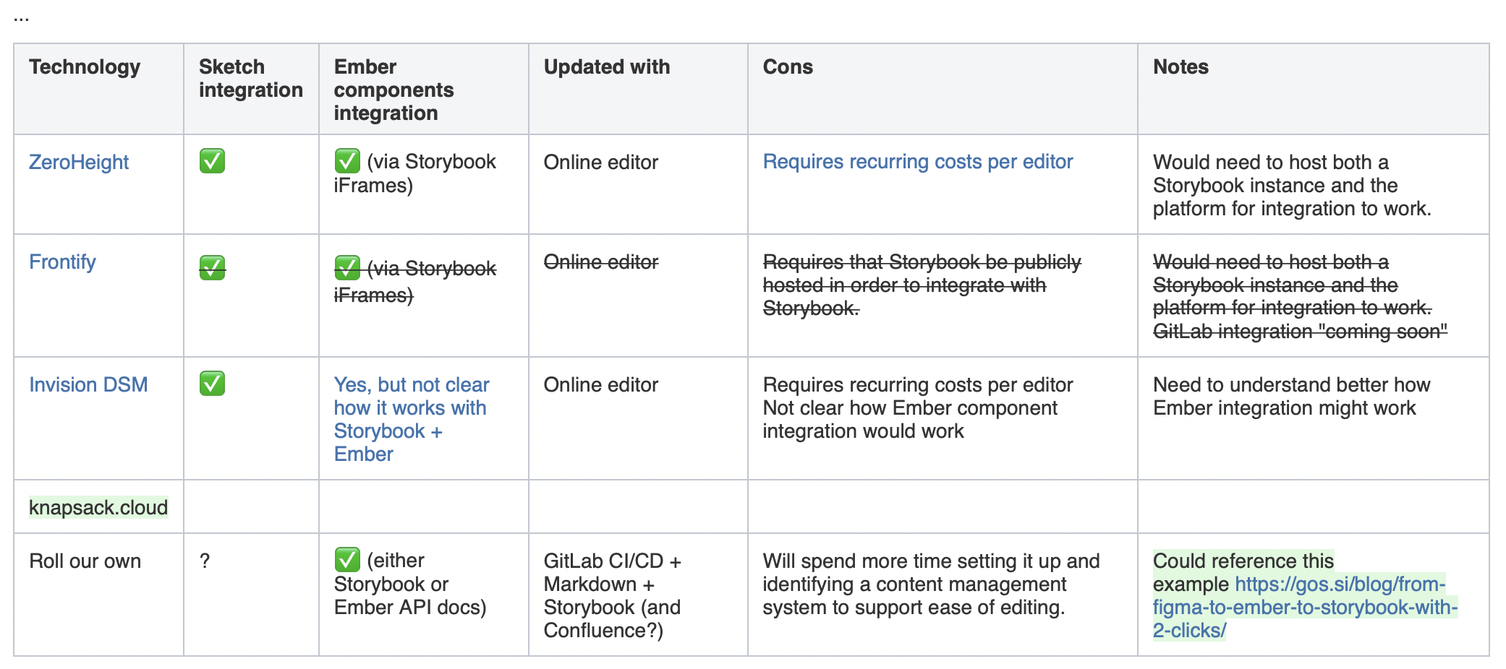
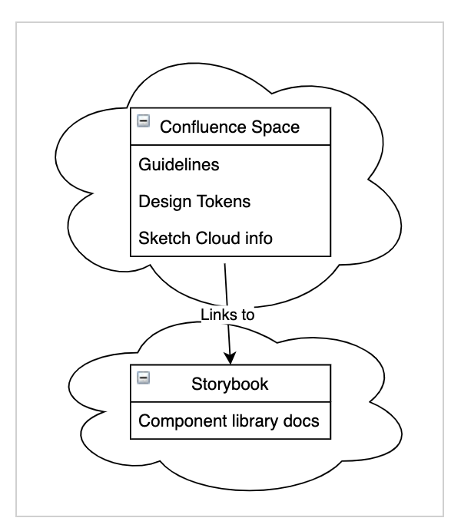
What we are doing to address these shortcomings?
Interactive Style Guide Website: Too many missing and outdated patterns. Documentation is not kept updated. Currently, we are investigating and evaluating other technologies that may make it easier for both Developers and Designers to easily contribute to and search through Design System guidance and patterns through a web UI, rather than be reliant on spinning up an Ember application within a local dev environment to see edits. These solutions also leverage Sketch Integration, making it easier to translate Sketch libraries into pattern components. Some platforms we are investigating are shown below:

Slide 5
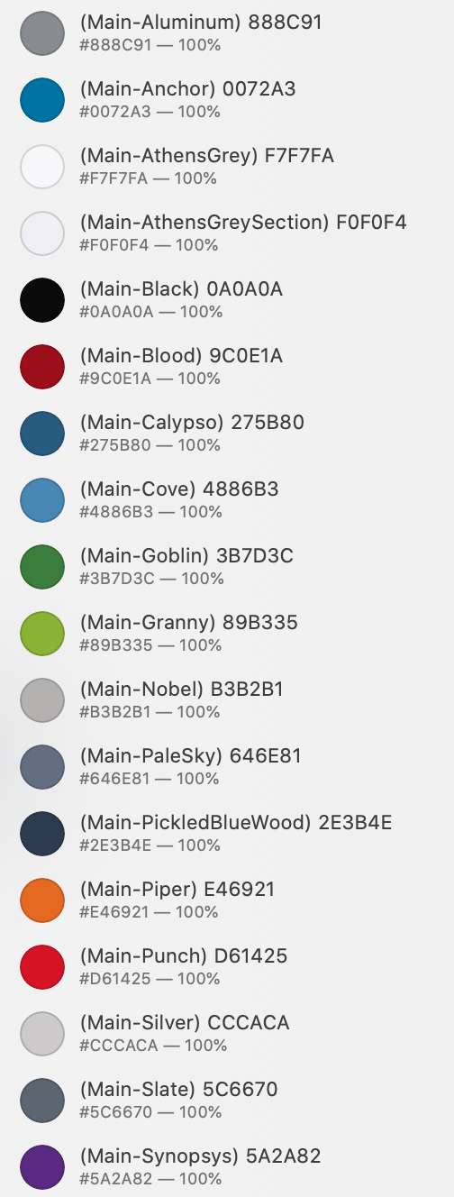
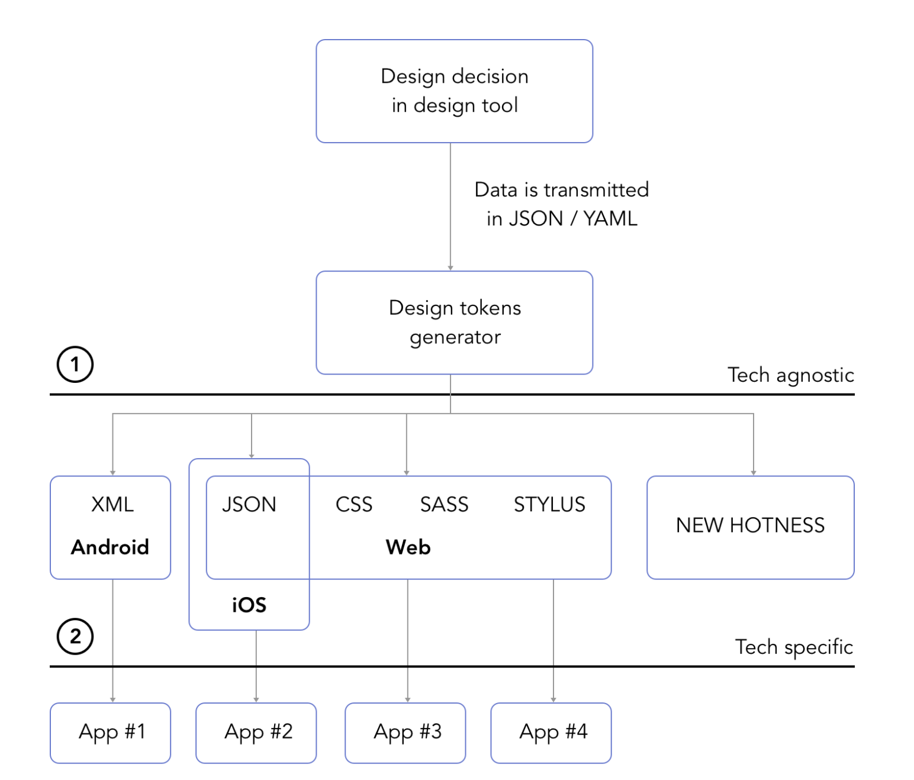
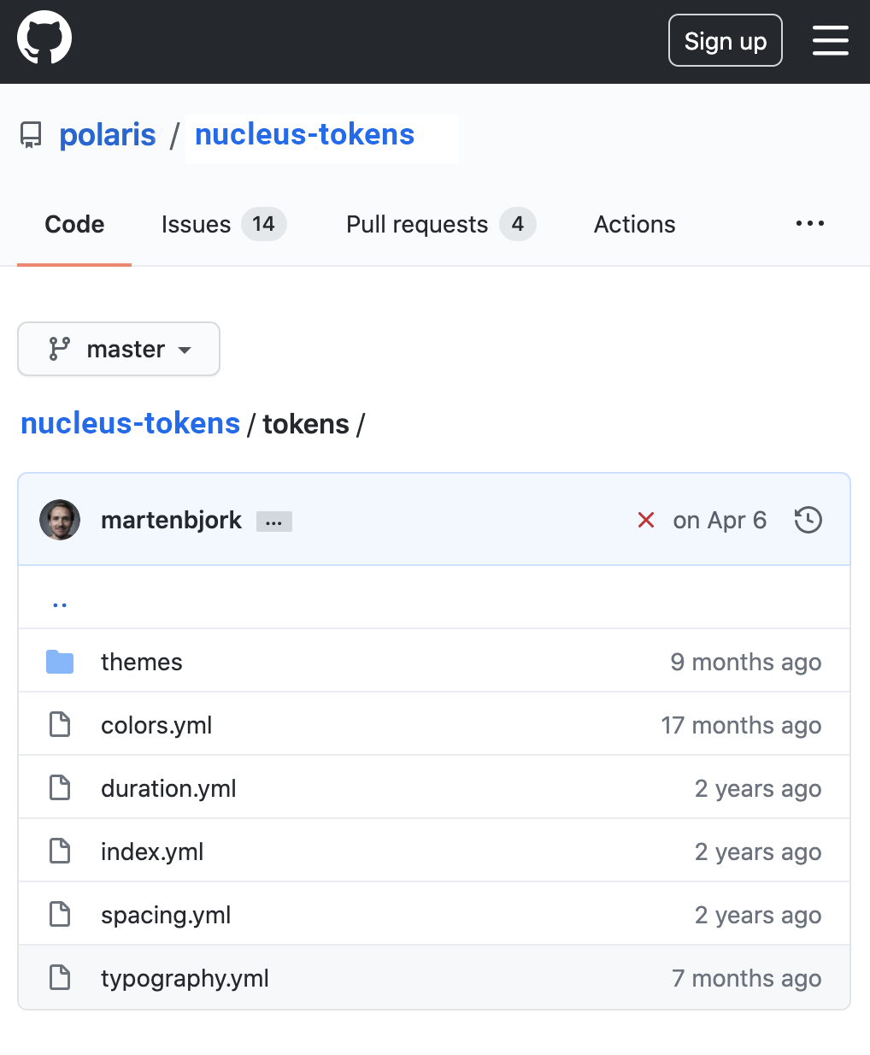
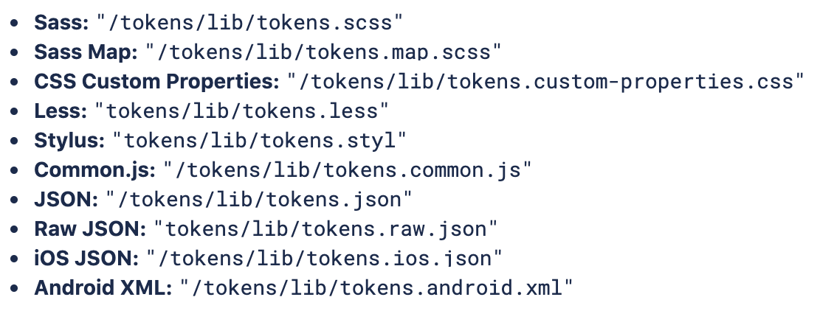
What we are doing to address these shortcomings?
Interactive Style Guide Website: No way to easily translate and port atomic branding elements. In order to make our Design System relevant to SIG product teams beyond Polaris, we are proposing to offer support for Design Tokens. These will allow us to share basic atomic design properties like colors, font properties and spacing agnostically across other development frameworks, promoting a unified look and feel even if UI component technology diverges from framework to framework.
Open-source Style Dictionary converts packages into variables suitable for a variety
of platforms and applications on those platforms
Sketch file saved as JSON or YML package, uploaded to GitLab repository and versioned
Design variables are
defined in Sketch

Slide 6
What we are doing to address these shortcomings?
Interactive Style Guide Website: Instructional language and terminology skews towards the developer persona. While much of the documentation currently found in the Interactive Design Guide will remain there, it will be updated, refined and further modified to allow for additional language that will speak to wider audiences who may also benefit from the Design System. Instructional language of a more technical nature, particularly regarding setup and installation of the Nucleus web application, may be moved into README documentation within the app’s GitLab repository. Meanwhile, we should encourage all team members to contribute to further Guidance documentation already started on Confluence. By crowdsourcing the creation of guidance within the UX team, we can take recommendations produced from audits, bug reports or usability research as they relate to the UI patterns and translate them to meaningful guidance that once refined and strategized can be used within the Design System. https://sig-confluence.internal.synopsys.com/x/yCQjKg

Slide 7
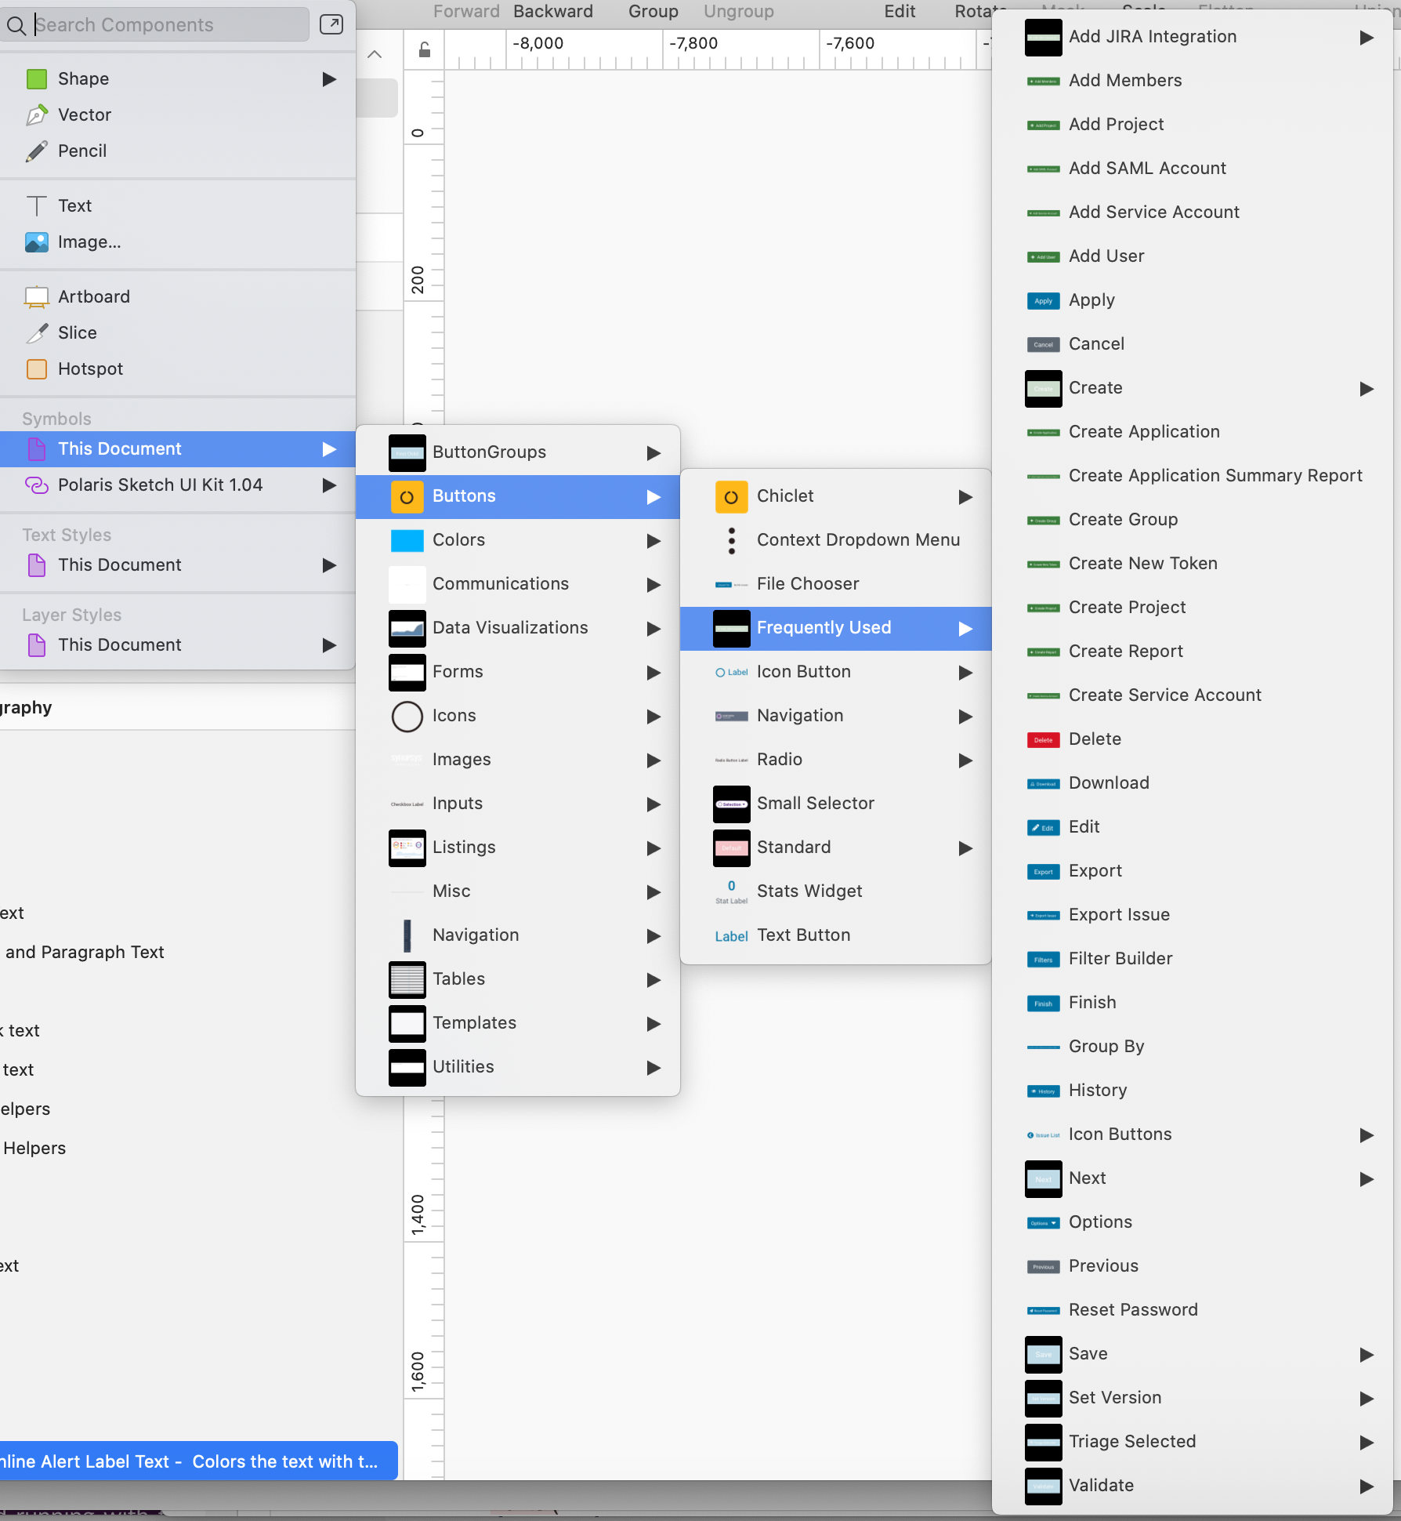
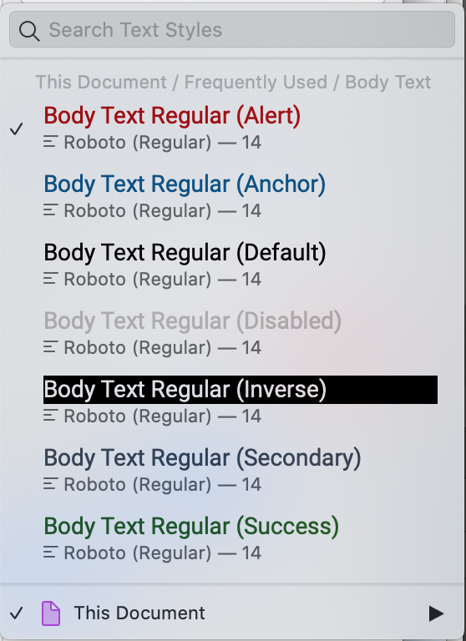
What we are doing to address these shortcomings?
Nucleus Sketch UI Kit: Too unwieldy and difficult to navigate through to find needed patterns. To help improve this, we are making several major changes to the original Nucleus Sketch UI Kit: 1. Better organization of symbols in a new taxonomy detached from that currently used in the Interactive Design Guide 2. Pre-constructed frequently used elements, (like the buttons shown to the right) ready to be inserted into the workspace, saving the user several steps to recreate. 3. Removal of unnecessary groupings within symbols, making it easier to make edits and overrides to atomic-level symbols within.
4. Reduction of unnecessary text styles, and consolidation of naming conventions based on sizes and weights – this will be helpful in identifying Design Tokens for typography variables (see some renamed styles on the left) – Headers and Body text are clearly defined and accessible.

Slide 8
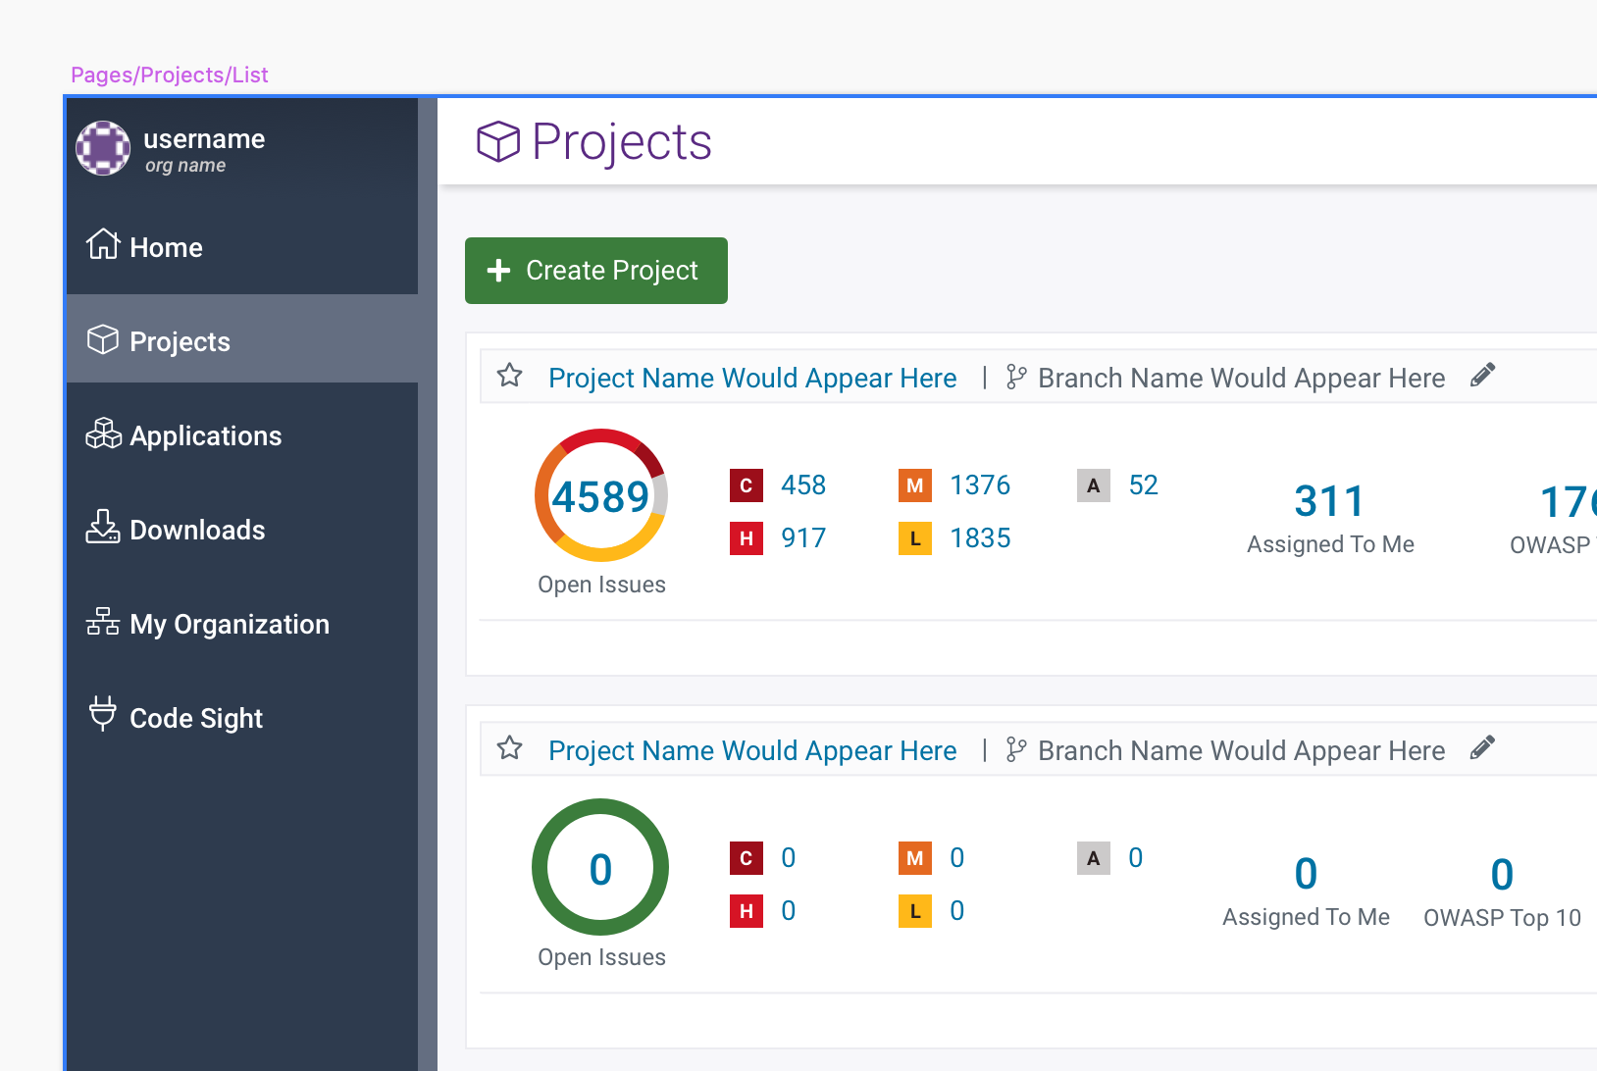
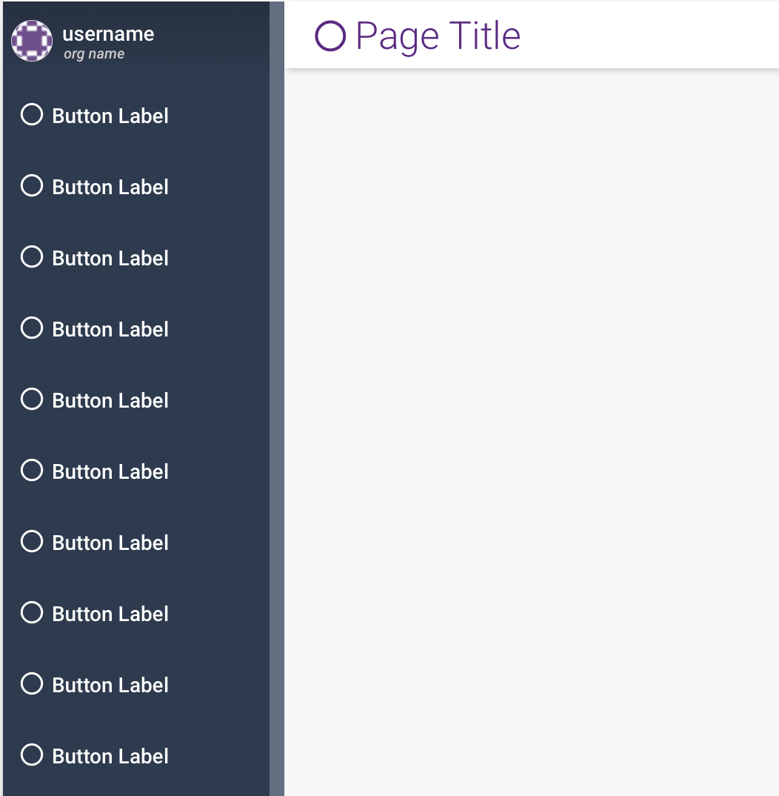
What we are doing to address these shortcomings?
Nucleus Sketch UI Kit: Designers are prevented from easily translating wireframes into high fidelity design specs. In addition, we will be making available a Polaris-specific Sketch UI Kit based on the revised Nucleus Kit. This will make it much easier for designers to translate high-fidelity mockups from wireframes by: 1. Providing Polaris-specific pages and page templates as Sketch symbols that can easily dragged and dropped into the workspace. These specific pages and templates are based on those defined in the Nucleus Kit, but they have Polaris-specific text and symbol overrides already in place, saving the designer much time editing elements like label names and icons from placeholders. 2. As base symbols are updated in Nucleus, Polaris-specific symbols built on them will inherit those changes as well, while maintaining their overrides. 3. We will schedule several workshops that will demonstrate how a combination of the Polaris and Nucleus Sketch Kits will allow you to create highly detailed mockups in a short period of time.

